Slide 1
SECURE DATA HIDING IN IMAGES USING STEGANOGRAPHY
SECURE THE DATA TO PREVENT HACKERS
Presented By --
Lakshman Prasad Latua : Jadavpur University (CSE)

Slide 2
OUTLINE
Problem Statement
Technology used
Wow factor
End users
Result
Conclusion
Git-hub Link
Future scope

Slide 3
Problem Statement
Data security is a major concern in digital communication.
Traditional encryption methods can attract attention.
Need for a method to hide sensitive information discreetly.
Steganography provides a way to embed data in images without noticeable changes.

Slide 4
Technology used
Steganography Techniques
Least Significant Bit (LSB) Method
Discrete Cosine Transform (DCT) Method
Spread Spectrum Techniques
Programming Language : Python
Libraries Used : OpenCV , NumPy

Slide 5
Wow factors
Invisible data embedding within images.
Difficult to detect without proper extraction methods.
Enhances security by making data transmission stealthy.
Can be combined with encryption for double-layer security.

Slide 6
End users
Cybersecurity Experts
Intelligence and Defense Agencies
Corporate Organizations
Journalists and Whistleblowers
General Users Concerned with Privacy

Slide 7
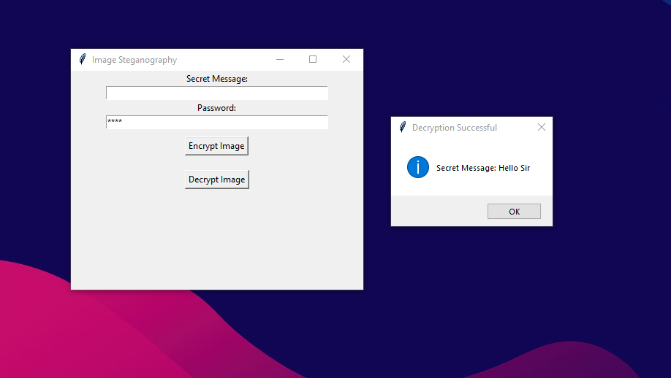
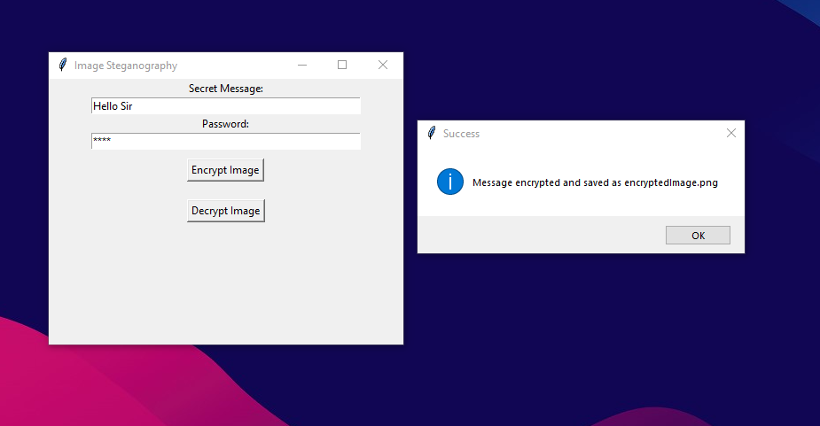
Results
Successful embedding and extraction of secret messages.
Minimal distortion in images, making detection difficult.
Secure and efficient data transfer with encryption layer.
Increased data security with imperceptible modifications.

Slide 8
Conclusion
Steganography is a powerful tool for secure communication.
Hides information in plain sight, reducing the risk of detection.
Can be further enhanced with AI-based techniques for improved security.
A valuable addition to modern cybersecurity strategies.

Slide 9
GitHub Link
https://github.com/0day-lakshman/Image_Steganography.git

Slide 10
Future scope
Integration with AI and machine learning for advanced steganalysis.
Real-time steganography for video streaming applications.
Enhanced security with blockchain-based verification.
Mobile applications for personal and corporate security solutions.

Slide 11
THANK YOU

